Slide 1

Chapter 3. Managing the Information Systems Project
조현보 (hcho@postech.ac.kr)
POSTECH 산업경영공학과
Industrial Data Engineering & Analytics Lab
http://idea-lab.kr

Slide 2

Collaborative Clarification
Students raise questions about parts they found difficult
Any students may answer and one additional student may add comments
The professor clarifies both the questions and answers if necessary
Students who raised questions and answered write down what they did (A Q&A sheet)

Slide 3


Importance of Successful Project Management
http://www.youtube.com/watch?v=OqTmSFkBqkg
http://www.youtube.com/watch?v=Mwi4OiJches
Notes:
1986년 Challenge호 take-off시에 폭발
2003년 Columbia호 Landing시에 폭발
➔ Politics

Slide 4
Operation Vs. Project
Rework of defective parts
Cold calling from sales department
Monitoring existing satellites
Recruiting cruise tourists
Training suppliers about business ethics
Removing black ices on the bridge
Developing zero-defect equipment
Development of a cold calling AI system
NASA’s Mars Exploration
Company S’s luxury cruise development
Finding a big new supplier
Building a bridge between two islands
Ongoing & Repetitive
Temporary & Unique
Notes:
프로젝트와 Operation의 차이 이해

Slide 5
Systems Development Life Cycle (SDLC)
Planning
Chapters 4-5
Analysis
Chapters 6-8
Design
Chapters 9-11
Implementation
Chapter 12
Maintenance
Chapter 12
What do we want to build, and why?
- Identifying and selecting systems development projects
- Initiating and planning systems development projects
What does the system need to do?
Determining requirements
Structuring process requirements
Structuring data requirments
The system is monitored, supported, and enhanced
How will the system work?
Designing database
Designing forms and reports
Designing interfaces and dialogues
The actual system is built, tested, and deployed

Slide 6
Questions on Missing Aspects in SDLC
Beyond the SDLC phases, what other activities do you think are essential for the success of an information system project?
Does the SDLC explicitly address risk management? How should risks be managed throughout the lifecycle?
How does SDLC handle stakeholder communication and expectations?
How does SDLC handle stakeholder communication and expectations?
How does the SDLC account for motivation and conflict resolution?
What role does change management play in system development?
How does the SDLC address legal, ethical, and compliance issues?
Project Management

Slide 7
Project
A project has a definite beginning and a definite end
A one-time effort undertaken to create a unique system, product, service, or result by progressive elaboration
A project creates unique deliverables; products, services, or results
A project is performed in steps, and continues by increments

Slide 8

If You Were the Project Manager …
What actions would you take if you were the project manager?
Before deciding what actions to take, keep in mind what your project is intended to create, such as a system, product, service, new process, or marketing plan.
Each student come to the board and write down the actions they would take.
Notes:
학생들에게 3분 정도의 시간을 주고 Project Manager가 해야 할 Activity를 하나씩 마음 속에 정리하라고 한다.
각 학생들이 앞으로 나와서 칠판에 쓰도록 한다
학생들이 쓴 활동을 우선 비슷한것 끼리 모은 다음, 시간 순으로 나열해 본다
지금 어느 단계에 있니라고 질문을 받을 때, 이렇게 자세한 활동을 이야기 하면 Communication이 어려우니 이 활동들을 그루핑한다. (주로 표준으로 제정)
다섯개의 그룹을 만들어 이름을 부친다 (initiating, Planning, Execution, Monitoring, Closing)

Slide 9
Function-Oriented View of Project Management
Okay, we’ve just organized the project management tasks into sequential phases.
Now, can we reorganize them into function-oriented groups, such as time management, cost management, and so on?

Slide 10

Formative Quiz
Begin with a short formative quiz based on the audio overview to assess comprehension
Students complete a quiz sheet and submit it (A quiz sheet)

Slide 11
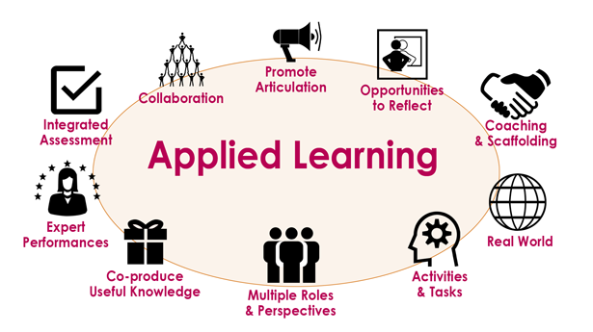
Applied Learning
Distribute a short case and its accompanying podcast if necessary
SAD 3 (Applied Learning) - Petrie Electronics
SAD 3 (Applied Learning) - CMLS-PM Case Study
Students would share their thoughts with peers
Students should write down their reflections (A reflection sheet)

Slide 12
Debating Statement
Should project managers strictly prioritize task specialization for team members over task variety?
Simple & Direct: "Should managers assign people just one type of job to make them experts, or give them many different jobs to keep them interested?"
Professional: "Is it better for project managers to focus on assigning specialized tasks for efficiency, or to ensure team members have a variety of work?"
Casual: "Should bosses keep everyone on the same task forever to get it done fast, or mix it up so they don't get bored?"
YES: Project managers should strictly prioritize task specialization.
NO: Project managers should NOT strictly prioritize specialization (Prioritize Variety).
Notes:
Background: The text notes that assigning a single task type to a worker (specialization) ensures they become efficient at that task. However, it also warns that specialization can lead to boredom and lowered morale, whereas variety can keep workers engaged but potentially lower efficiency. The debate centers on whether efficiency or team morale/skill-redundancy should be the primary driver of assignment strategy.
Debate Arguments: Task Specialization vs. Task Variety
YES: Project managers should strictly prioritize task specialization.
It creates maximum efficiency: Assigning a single task type (or very few) to a worker ensures that they become highly efficient at that particular activity because they repeat it constantly.
It optimizes for speed and quality: Managers can assign tasks based on specific personality traits or skills. For example, a meticulous worker can be assigned all quality-critical tasks, while a fast worker is assigned all time-critical tasks, ensuring the best outcome for every part of the project.
It reduces "Switching Costs": By keeping a team member on one type of task (e.g., creating all system reports), they do not lose time mentally switching between different types of work or tools.
NO: Project managers should NOT strictly prioritize specialization (Prioritize Variety).
It leads to boredom and low morale: The text warns that a worker may become bored if a task is too specialized or continues for a long duration, which can negatively affect the work environment.
It hinders skill development: It is important to give people tasks that allow them to learn new skills. Strict specialization prevents team members from growing and learning new parts of the system.
A "Middle Ground" is safer: While variety might lower raw efficiency slightly, a balanced approach avoids the burnout of specialization while still getting work done. The text suggests the best approach is often a "middle ground" rather than strict specialization.

Slide 13
Debating Statement
Is the project manager’s leadership and interpersonal skill set more critical than technical expertise for IS project success?
Simple & Direct: "Is being a good leader and 'people person' more important for a project manager than knowing the technical details?"
Professional: "For an information systems project to succeed, are a manager's leadership and communication skills more valuable than their technical knowledge?"
Casual: "What matters more for a project manager: having great people skills or being a tech wizard?"
YES: Leadership and Interpersonal Skills are More Critical.
NO: Technical Expertise is Equally or More Critical (or the Foundation).
Notes:
Background: Table 3-1 highlights leadership, conflict management, communication, and customer relations as core project manager skills, many of which are non-technical. This raises debate over whether technical mastery or people management ultimately determines outcomes in complex systems projects.
The outlines are explicitly grounded in Managing the Information Systems Project and are designed so that strong arguments require deep engagement with the chapter’s concepts, not generic opinions.
YES: Leadership and Interpersonal Skills are More Critical.
Project Management is primarily about people, not code:
The text explicitly notes that "many of the skills are related to personnel or general management, not simply technical skills".
The project manager is described as a "juggler" who must handle customer expectations, organizational change, and contractor relations, all of which are interpersonal tasks rather than technical ones.
Conflict and Team Management determine stability:
A key activity for project managers is "Conflict management," specifically ensuring that conflict within a team is not too high, which requires strong interpersonal skills rather than technical ones.
"Team management" involves managing the project team for effective performance, including peer evaluations and team building, which are leadership functions.
Customer Relations drive project alignment:
"Customer relations" is listed as a critical skill, requiring the manager to interpret system requests and act as a contact point for customers.
Establishing a relationship with the customer is a specific initiation activity designed to build "stronger partnerships and higher levels of trust," which is essential for success regardless of technical prowess.
NO: Technical Expertise is Equally or More Critical (or the Foundation).
The Project Manager is defined as a Technical Analyst:
The text defines a project manager as "a systems analyst with a diverse set of skills," implying that technical competence (the analyst role) is the prerequisite foundation for the position.
In many organizations, the project manager is explicitly a "very experienced systems analyst".
Technical Problem Solving is a required core skill:
Table 3-1 lists "Technical problem solving" as a core skill, requiring the manager to interpret specifications and "design solutions to problems".
Without technical expertise, a manager cannot effectively define and sequence the detailed technical activities required for the "Work breakdown structure".
Resource and Risk Estimation requires technical insight:
Managers must use technical models like COCOMO to estimate the size and cost of software, which requires understanding "project characteristics" and complexity.
Identifying risks involves assessing "new technology" or "team member inexperience with technology," judgments that require deep technical understanding to make accurately

Slide 14
Thank you

Slide 15
Introduction

Slide 16
Project Management
So far, how an information systems project moves through the SDLC’s five phases have been explained
Today’s IS projects have become more complex and lengthier
In the past, focused on very large, custom-designed, stand-alone applications
Today, focusing on packaged software, e.g., ERP, data lake, etc. as data abounds
Additionally, transitioning legacy applications to accommodate Web-based interfaces
Consequently, the system analyst should gain an understanding of the project management process as a project manager
Consider the two distinct roles, whether performed by a single person or by two separate individuals

Slide 17
Use Case: PVF

Slide 18
Company Background
PVF manufactures high-quality wood furniture for retail stores in the U.S.
PVF was organized into the following functional areas in 2000
Manufacturing (fabrication, assembling, finishing)
Sales
Orders
Accounting
Purchasing
PVF used 3 computer application systems

Slide 19
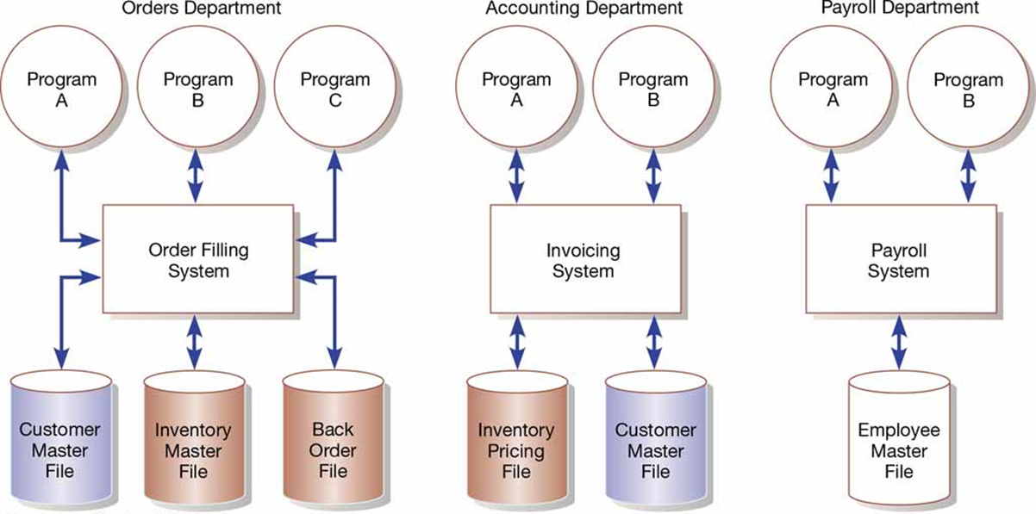
Three Computer Applications

Slide 20
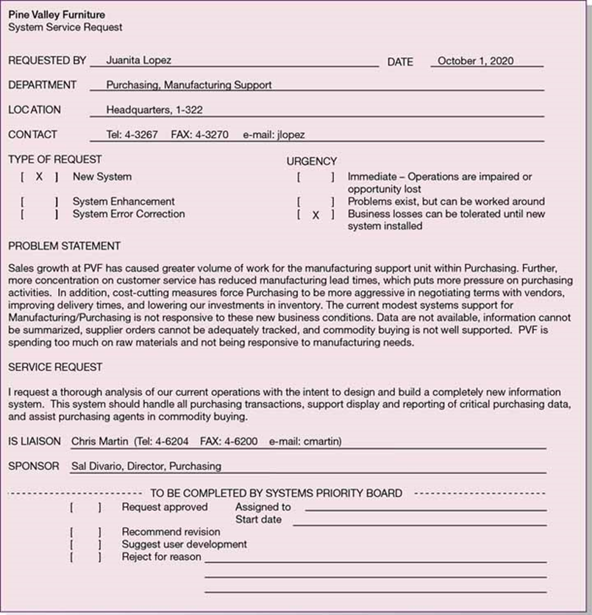
Project proposal: System Service Request (SRS)
A Standard form for requesting systems development work
The systems priority board evaluates all the requests in relation to the business challenges or opportunities the system will solve or create

Slide 21
Managing the Information Systems Project

Slide 22
Systems Development Life Cycle (SDLC)
Planning
Chapters 4-5
Analysis
Chapters 6-8
Design
Chapters 9-11
Implementation
Chapter 12
Maintenance
Chapter 12
What do we want to build, and why?
- Identifying and selecting systems development projects
- Initiating and planning systems development projects
What does the system need to do?
Determining requirements
Structuring process requirements
Structuring data requirments
The system is monitored, supported, and enhanced
How will the system work?
Designing database
Designing forms and reports
Designing interfaces and dialogues
The actual system is built, tested, and deployed

Slide 23
Questions on Missing Aspects in SDLC
Beyond the SDLC phases, what other activities do you think are essential for the success of an information system project?
Does the SDLC explicitly address risk management? How should risks be managed throughout the lifecycle?
How does SDLC handle stakeholder communication and expectations?
How does SDLC handle stakeholder communication and expectations?
How does the SDLC account for motivation and conflict resolution?
What role does change management play in system development?
How does the SDLC address legal, ethical, and compliance issues?
Project Management

Slide 24
Project
A project has a definite beginning and a definite end
A one-time effort undertaken to create a unique system, product, service, or result by progressive elaboration
A project creates unique deliverables; products, services, or results
A project is performed in steps, and continues by increments

Slide 25
Trends from Operation to Project
중요도
Project
Operation
Time
1800s
Agricultural society
1900s
Industrial society
2000s
Information society
2010s
Knowledge society
Notes:
글로벌 경쟁, 파괴적 혁신에 따르는 기업경쟁력 확보를 위한 사업화 (Business Model)의 발굴이 중요해지고 있음

Slide 26
Project Vs. Operation
H사의 신차 개발
NASA의 화성탐사
S사의 초호화 유람선 개발
정부의 환경규제에 부합하는 공정 개선
제조현장의 암묵지를 형식지화 하는 체계 정립
새 대형 엔지니어링사를 고객사로 발굴
H사의 심해저 특수구조물 신제품 개발
신공정 가동 시작
불량품 재처리
판매부서의 Cold Calling
주요 고객사의 불만 접수 및 개선
자사 홈페이지에 등록되는 질문에 신속한 응답
고객들의 주문정보를 취합하여 ERP 시스템에 키인
월례 임원진 보고회 참석
Temporary
Ongoing
Unique
Repetitive
Project
Operation
Notes:
프로젝트와 Operation의 차이 이해

Slide 27
Project Management
The process to oversee and control the development of an information system while staying within budget, adhering to the schedule, and aligning with business objectives
The key functionalities of project management
Defining project scope and objectives
Managing resources (Allocate resource, Balance workload)
Controlling timelines and budgets
Coordinating tasks (Define work breakdown structure, Monitor)
Mitigating risks and resolve issues
Facilitating communication (Translate technical concepts, Share progress status)
Ensuring quality
Managing changes

Slide 28
Project Management Activities
Prompt: Project management is the process of overseeing and controlling the development of an information system while staying within budget, adhering to the schedule, and aligning with business objectives. Please provide a complete list of project management activities and organize them into a few groups
During initiation, projects & participants (PM, SA, etc.) are selected
During planning, the PM asks the SA to plan (estimate costs, times, resources, etc.)
During execution, the PM asks the SA to do the planned tasks at the scheduled time
During monitoring & controlling, the PM adjusts costs, times, resources, etc.
During closing, the PM
Prompt: A project manager perform these activities by interacting with all stakeholders. Identify a list of stakeholders, and explain how a project manager interacts with them?

Slide 29
Project Manager vs. System Analyst vs. Developer
Prompt: It is assumed that a project manager interacts with both system analysts and software developers involved in the SDLC. Describe and illustrate their respective relationships in terms of their functionalities
Note that a single person can assume all three stakeholder roles depending on the project's size, scope, and resource availability
In smaller projects, one person may be responsible for overseeing project management tasks, analyzing system requirements, and developing the actual system
This consolidation of roles can streamline communication and decision-making but may also pose challenges in balancing responsibilities and maintaining efficiency

Slide 30
Initiation

Slide 31
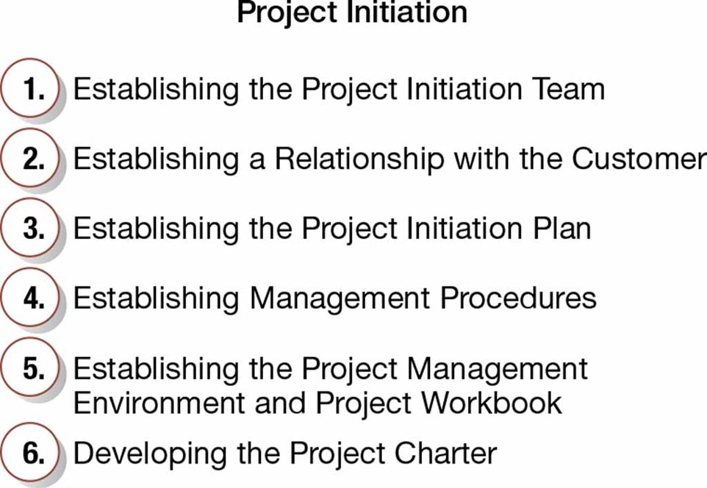
Developing the Project Charter
A short (typically one page), high-level document prepared for the customer that describes deliverables and the critical information
Contents
Project title and date of authorization
Project manager name and contact
Customer name and contact
Projected start and completion dates
Key stakeholders, project role, and responsibilities
Project objectives and description
Key assumptions or approach
Signature section for key stakeholders

Slide 32
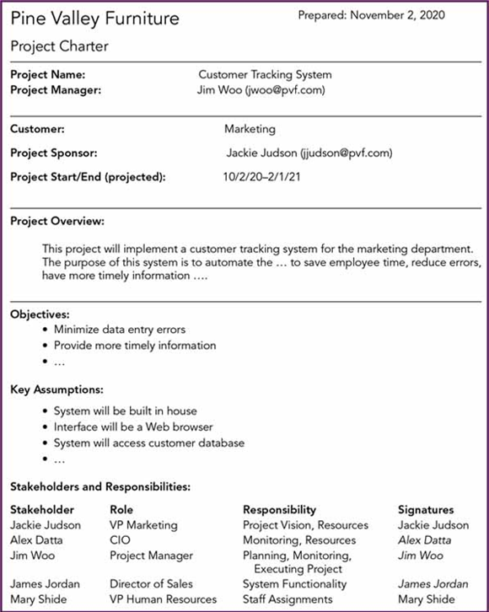
PVF’s Project Charter

Slide 33
Planning

Slide 34
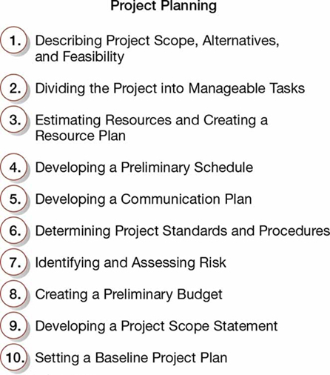
Ten Project Planning Activities

Slide 35
Dividing the Project into Manageable Tasks
To divide the entire project into manageable tasks and build Work Breakdown Structure (WBS)
Too much detail in task complicates project management, while too little detail obscures the project's status and task interdependencies
Characteristics of a Task:
Assignable
Identifiable deliverables
Known methodologies or techniques
Defined predecessors and successors
Measurability in terms of progress

Slide 36
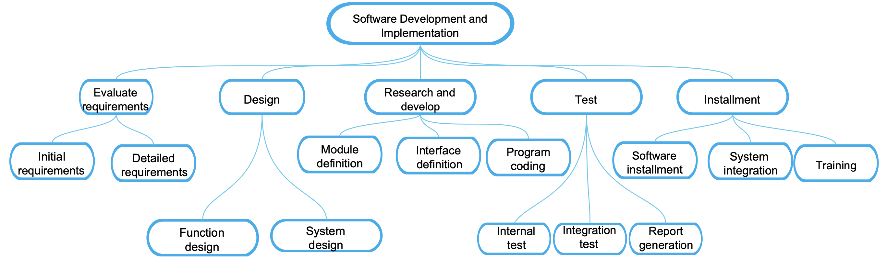
Example of WBS
Tasks to be sequenced

Slide 37
Task Sequence & Network Diagram
Determining task sequence depends on the interdependencies of tasks, the availability of critical resources, client-imposed constraints
Network diagram
Nodes represent tasks
Arrows connect nodes, thus creating a logical relationship between these tasks
E.g., ‘Function design’ must finish before ‘Module definition’ starts
E.g., ‘Function design’ and ‘System design’ have no precedence
E.g., Both ‘Module definition’ and ‘Interface definition’ must finish before ‘Program coding’ starts
Function design
Module definition
Software installment
System integration
Initial requirements
Detailed requirements
Program coding
Internal test
Integration test
Report generation
System design
Interface definition
Training

Slide 38
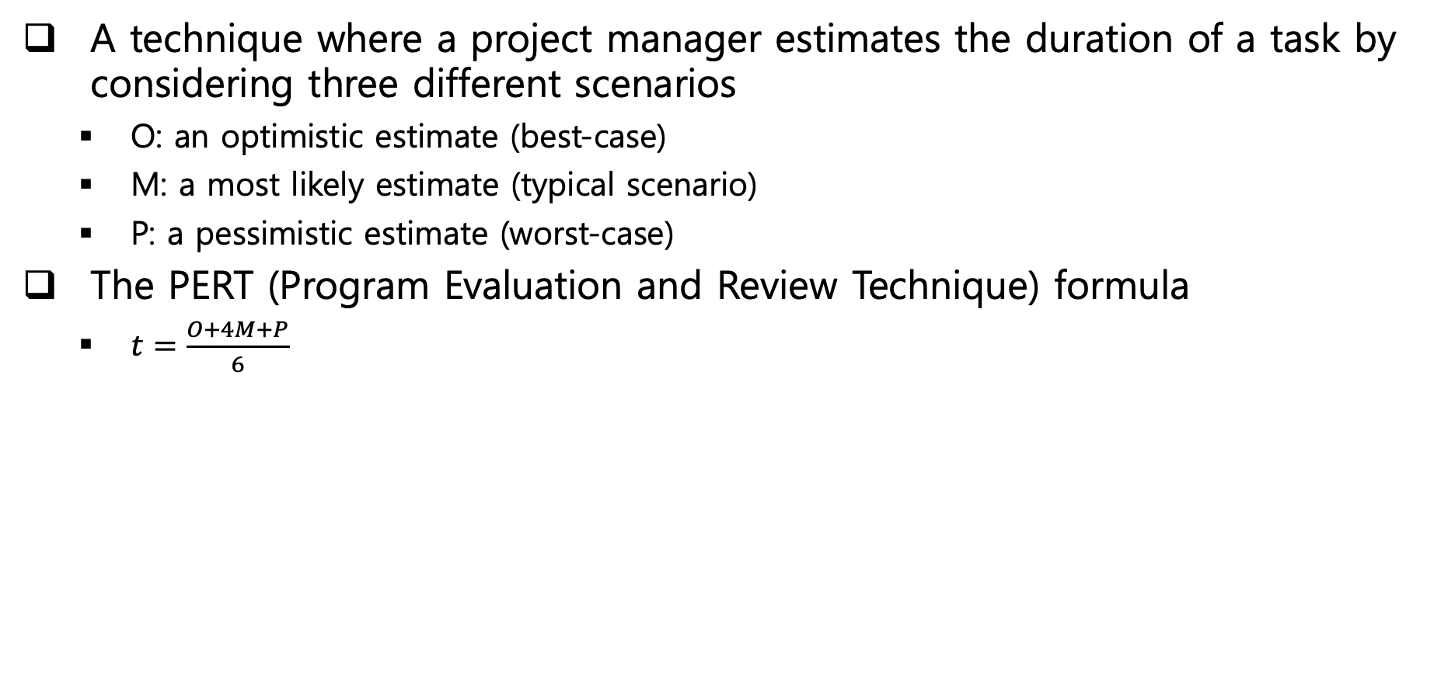
Three-Point Duration Estimation
A technique where a project manager estimates the duration of a task by considering three different scenarios
O: an optimistic estimate (best-case)
M: a most likely estimate (typical scenario)
P: a pessimistic estimate (worst-case)
The PERT (Program Evaluation and Review Technique) formula
$t=\frac{O+4M+P}{6}$
9
8
3
9
5
8
Function design
Module definition
Software installment
System integration
5
4
7
3
Initial requirements
Detailed requirements
Program coding
Internal test
Integration test
Report generation
8
7
5
System design
Interface definition
Training

Slide 39
Critical Path Method (CPM)
The critical path is the sequence of tasks that represent the longest path through a project
This determines the shortest project “duration”
Note that all the tasks need to be completed
Slack or float is the amount of time that a task can be delayed without delaying the project finish date
The slack of critical tasks is zero
9
8
3
9
5
8
Function design
Module definition
Software installment
System integration
5
4
7
3
Initial requirements
Detailed requirements
Program coding
Internal test
Integration test
Report generation
8
7
5
System design
Interface definition
Training

Slide 40
Calculating the Critical Path
1. Calculate Earliest Start & Earliest Finish times of each task (Forward Pass)
2. Calculate Latest Start & Latest Finish times of each task (Backward Pass)
3. Identify tasks with 0 (zero) slack
ES=13, EF=22
ES=22, EF=30
ES=49, EF=52
ES=52, EF=61
9
8
3
9
ES=0, EF=5
ES=5, EF=13
ES=30, EF=35
5
8
Function design
Module definition
Software installment
System integration
5
4
7
3
Initial requirements
Detailed requirements
Program coding
Internal test
Integration test
Report generation
8
7
5
System design
Interface definition
Training
ES=13, EF=21
ES=21, EF=28
ES=49, EF=54
LS=13, LF=22
ES=22, LF=30
LS=49, LF=52
LS=52, LF=61
9
8
3
9
EF=0, LF=5
EF=5, LF=13
LS=30, EF=35
Function design
Module definition
LS=46, LF=49
Software installment
System integration
5
8
5
4
7
3
Initial requirements
Detailed requirements
Program coding
Internal test
Integration test
Report generation
8
7
5
System design
Interface definition
Training
EF=15, LF=23
Slack=2
ES=23, LF=30
Slack=2
LS=56, LF=61
Slack=LS-ES=7

Slide 41
Earliest Time – Forward Pass, Latest Time – Backward Pass
ES_{i} : Earliest Start Time of task i
EF_{i} : Earliest Finish Time of task i
LS_{i} : Latest Start Time of task i
LF_{i} : Latest Finish Time of task i
t_{A}
t_{C}
t_{D}
A
t_{C}
t_{D}
t_{A}
C
D
t_{B}
C
D
A
t_{B}
E
B
B
ES_{C}=max{EF_{A}, EF_{B}}=max{ES_{A}+t_{A}, ES_{B}+t_{B}}
ES_{D}=EF_{C}=ES_{C}+t_{C}
Note that the ESs of start nodes = 0
LF_{C}=LS_{D}=LF_{D}-t_{D}
LF_{A}=min{LS_{C}, LS_{B}}=min{LF_{C}-t_{C}, LF_{B}-t_{B}}
Note that the LFs of end nodes = EFs
Notes:
가장 빠른 시작시간 (ES)
프로젝트의 개시 시간을 기준점으로 하여 어느 작업을 시작할 수 있는 가장 빠른 시점을 뜻한다.
선행작업의 완료시간을 기준으로 이벤트에서의 경과시간을 더하여 후속작업의 빠른 시작시간을 계산한다.
가장 빠른 완료시간 (EF)
어느 작업을 끝낼 수 있는 가장 빠른 시점으로서 그 작업의 가장 빠른 시작시간에 작업기간을 더하여 계산한다.

Slide 42
Uncertainty
Kinds of uncertainties
Task duration is uncertain
Resource availability is uncertain
Most task durations are inflated
People often add a buffer regardless of whether it is needed or not
This results in side effects, due to Parkinson’s Law (or Student Syndrome)
Work intentionally expands to fill the time allowed

Slide 43
How to Deal with “Duration Uncertainty”
The critical chain method removes buffers from individual tasks and instead places buffers on any schedule path (Risk aggregation)
Critical path method
Task
Buffer
Task
Buffer
Task
Buffer
Task A
Task B
Task C
to protect the target finish date from slippage
Critical chain method
to protect the critical chain from being delayed by the lateness of tasks on the non-critical chain

Slide 44
How to Deal with “Resource Availability”
Now assume that B & C request the same resources
Then the two tasks, B and C, needed to be serialized
We identify the longest chain of dependent tasks by resource - Critical Chain
B(5)
B(5)
A(7)
D(3)
A(7)
D(3)
C(2)
C(2)
E(3)
E(3)
Critical Path: A-B-D
Critical Chain: A-C-B-D (17)

Slide 45
Schedule Compression
A technique to shorten the duration of critical tasks without changing the scope: Crashing, Fast Tracking
Crashing
By borrowing resources, expediting materials, asking overtime, etc.
Assigning more resources to the task that gives the greatest amount of schedule compression with the least incremental cost
Fast Tracking
Executing tasks that were originally scheduled in sequence in parallel

Slide 46
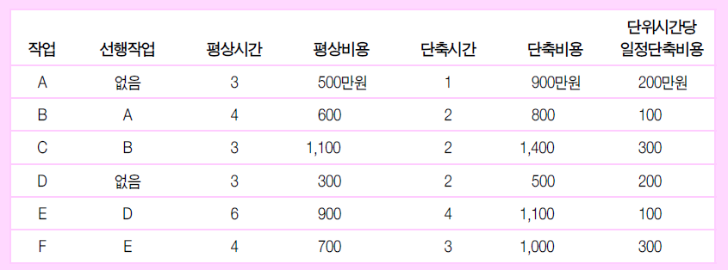
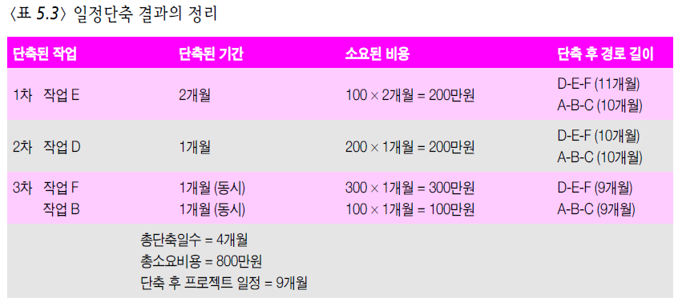
Schedule Compression – Crashing Example
3
4
3
A
B
C
Begin
End
D
E
F
3
6
4
Critical task 중에 최소 일정단축비용
Critical path
Critical path
2개의 Critical task를 동시에 줄여야 함

Slide 47
Cost of Schedule Compression (Crashing)
Crashing Cost/Month =
Crashing Cost – Normal Cost
Normal Time – Crashing Time
Task Cost
49000 – 41000
13 – 9
Crashing
=
49,000 –
–
–
–
41,000 –
–
8000
4 Months
= = 2000/Month
Crashing Cost
Normal
Normal Cost
| | |
0 9 13
Time (Months)
Crashing Time
Normal Time

